Slide 1
Lesson 8-1 Thermodynamics
CS 185C: Introduction to Numerical Ocean Modeling

Slide 2
Learning Objectives
Describe how advection influences heat transport
Distinguish between Lagrangian and Eulerian derivatives
Write down the 3D equations for temperature and salinity that are used in ocean models
Quantify northward heat advection in the Gulf Stream

Slide 3
Previous Exploration of Heat
Our rod starts at 10⁰C
But then we hit it with a blow torch so its warmer in the middle at 12⁰C
Question: How does the temperature evolve through time?

Slide 4
Thermodynamics in 1D

Slide 5


Reconsidering diffusion in a fluid
Heat diffuses from one cube to another given by the diffusion equation:
$$\frac{∂T}{∂t}=κ\frac{∂^{2}T }{∂x^{2}}$$
Key assumption: No water movement

Slide 6

Consider This: A Slanted Ramp
Slanted ramp induces a background velocity u
u
If we follow our parcel along its flow,
heat diffuses from one cube to another given by the diffusion equation:
$$\frac{DT}{Dt}=κ\frac{∂^{2}T }{∂x^{2}}$$
New symbol D indicates we are following along the fluid flow

Slide 7
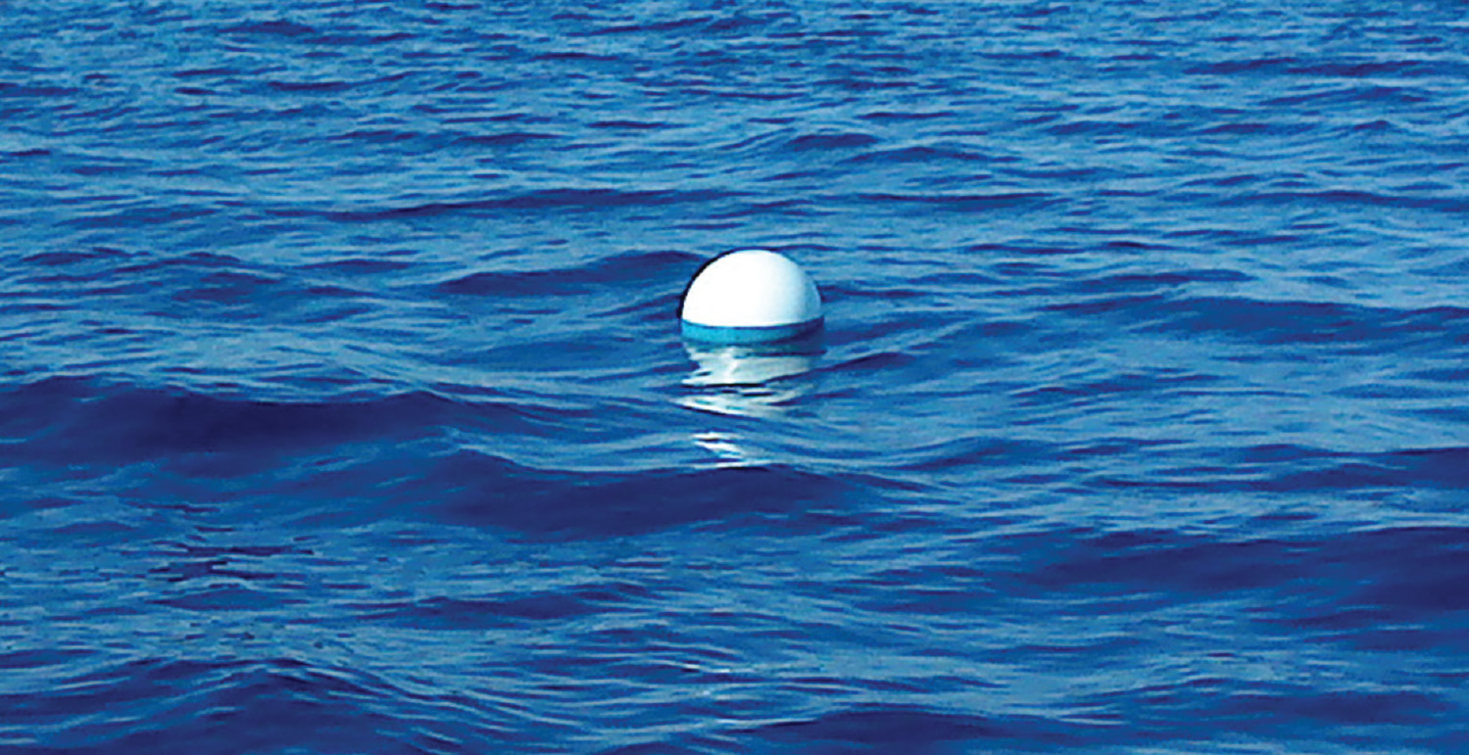
Lagrangian Derivative
A Lagrangian derivative measures how a property changes through time along the path of fluid flow
Drifters in the ocean follow ocean currents
A Drifting Buoy a.k.a. a ”Lagrangian Drifter”
See the LDL HERE
Notes:
https://gdp.ucsd.edu/ldl/

Slide 8
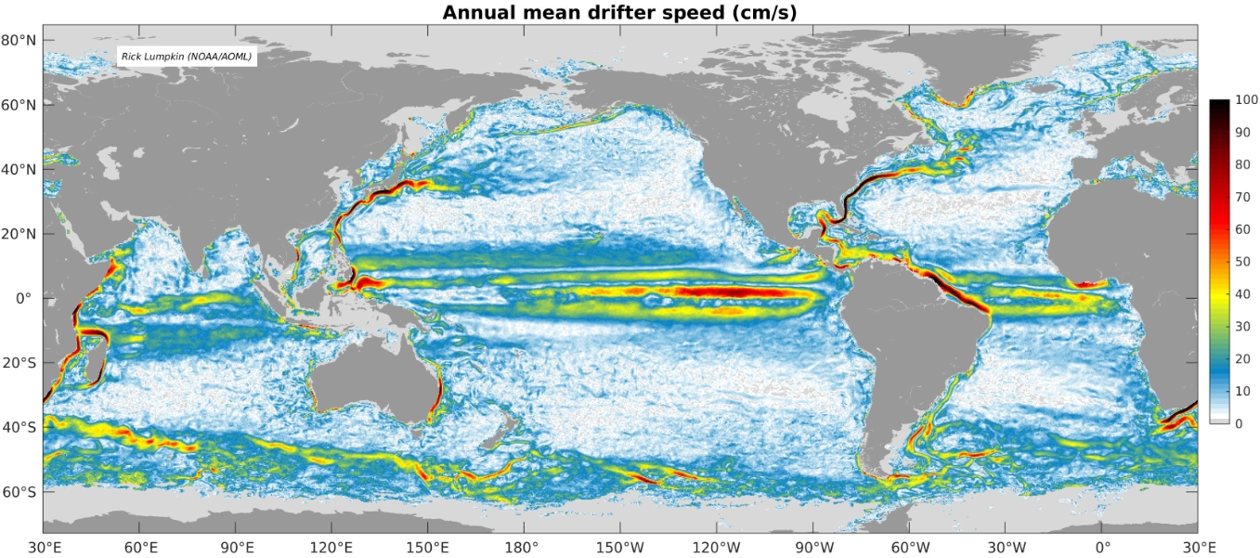
Ocean Drifters
Lagrangian drifters reveal the mean flow speeds in the ocean
Notes:
https://www.aoml.noaa.gov/phod/gdp/mean_velocity.php

Slide 9



Consider This: A Slanted Ramp
Slanted ramp induces a background velocity u
u
$$x_{0}$$
Question: What is the change in temperature at a given location $x_{0}$?
$$\frac{∂T}{∂t}$$
The symbol $∂$ indicates we are considering the derivative at a given location

Slide 10
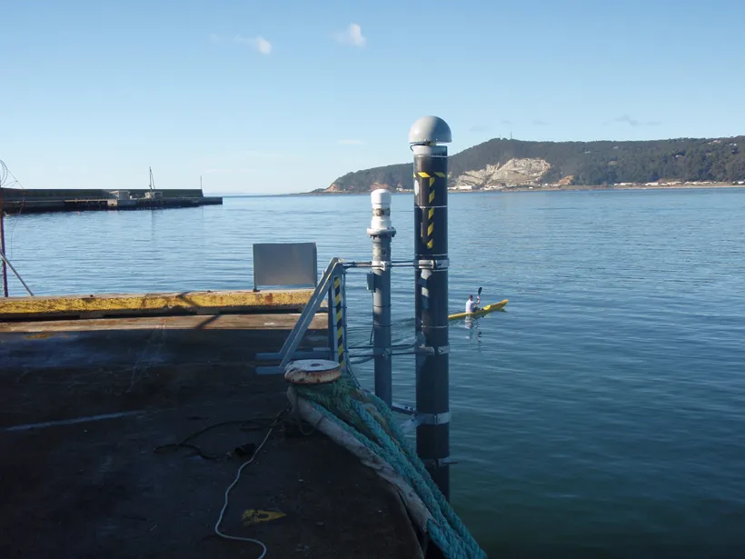
Eulerian Derivative
An Eulerian derivative measures how a property changes through time at a single location
Instruments attached to structures are subject to changes from incoming currents and from local variables
Instruments at the end of a pier a.k.a. an Eulerian instrument

Slide 11


Consider This: A Slanted Ramp
Slanted ramp induces a background velocity u
u
At a given location $x_{0}$,
the change in temperature depends on
The background velocity u
The gradient in temperature
$$x_{0}$$
$$\frac{∂T}{∂t}=−\frac{∂T}{∂x}\frac{∂x}{∂t}=−u\frac{∂T}{∂x}$$

Slide 12

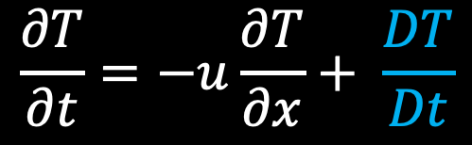
The Lagrangian Derivative
a.k.a. the Total Derivative
a.k.a. the Material Derivative
a.k.a. the Advective Derivative
If any other changes are occurring as the cube floats by, then they also influence the right side of the equation
$$\frac{∂T}{∂t}=−u\frac{∂T}{∂x}+ \frac{DT}{Dt}$$
Often, we write this equation as:
$$\frac{DT}{Dt}=\frac{∂T}{∂t}+u\frac{∂T}{∂x}$$
…changes that happen locally….
… and changes that occur as a result of advection.
The Lagrangian Derivative takes into account…

Slide 13
Thermodynamics in 3D

Slide 14
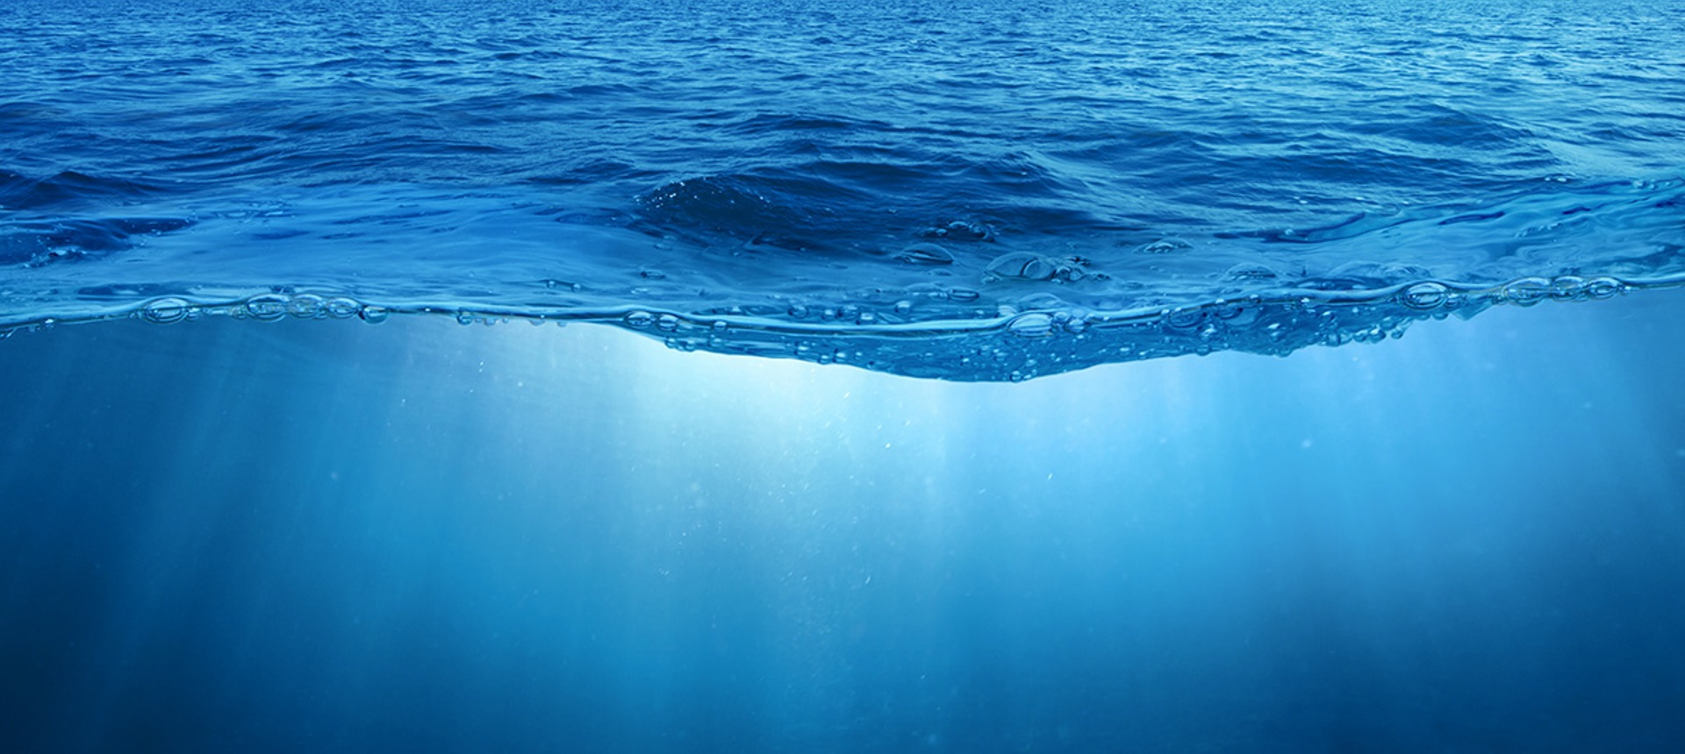

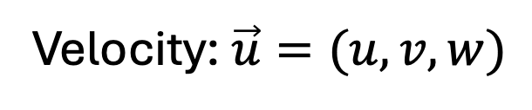


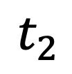
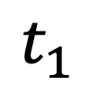
Consider a small cube of water
$$t_{2}$$
$$t_{1}$$
Particle Path
$$z$$
Little Cube
Velocity: $\vec{u}=(u,v,w)$
$$y$$
$$x$$

Slide 15



Total Derivative in 3D
$$\frac{DT}{Dt}=\frac{∂T}{∂t}+u\frac{∂T}{∂x}+v\frac{∂T}{∂y}+w\frac{∂T}{∂z}$$
$$=\frac{∂T}{∂t}+\left(u,v,w\right)⋅\left(\frac{∂T}{∂x},\frac{∂T}{∂y},\frac{∂T}{∂z}\right)$$
$$=\frac{∂T}{∂t}+\vec{u}∙∇T$$

Slide 16


The Ocean Heat Equation
$$\frac{∂T}{∂t}=−\vec{u}∙∇T+κ\frac{∂^{2}T}{∂t^{2}}+J_{T}$$
… advected temperature …
The change in temperature at a given location is associated with …
… diffusion…
… and other sources such as solar radiation, sea ice formation, radiative cooling, etc
The heat equation is typically written in terms of the Lagrangian derivative as:
$$\frac{DT}{Dt}=κ\frac{∂^{2}T}{∂t^{2}}+J_{T}$$

Slide 17
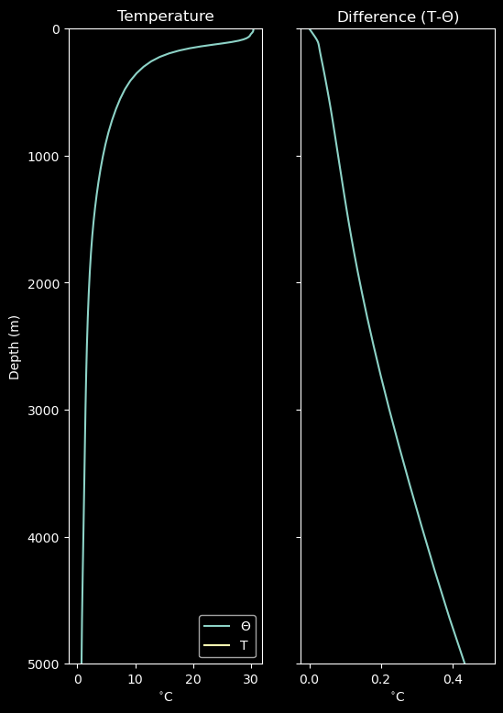
Potential Temperature
When water is put under pressure, it changes temperature adiabatically
Adiabatic = without exchange of heat
Water with the same temperature at two different depths does not have the same amount of heat (🤔)
For honest comparison, use potential temperature - the temperature a parcel would have if it were brought to the surface adiabatically
PT is not affected by dynamics and easier to track in the ocean (otherwise a model would need to compute adiabatic changes to temperature)

Slide 18


The Ocean Heat Equation (Revised)
$$\frac{∂Θ}{∂t}=−\vec{u}∙∇Θ+κ\frac{∂^{2}Θ}{∂t^{2}}+\frac{J_{H}}{C_{p}ρ_{w}}$$
… advected temperature …
The change in temperature at a given location is associated with …
… diffusion…
… and other sources such as solar radiation, sea ice formation, radiative cooling, etc
The heat equation is typically written in terms of the Lagrangian derivative as:
$$\frac{DΘ}{Dt}=κ\frac{∂^{2}Θ}{∂t^{2}}+\frac{J_{H}}{C_{p}ρ_{w}}$$

Slide 19
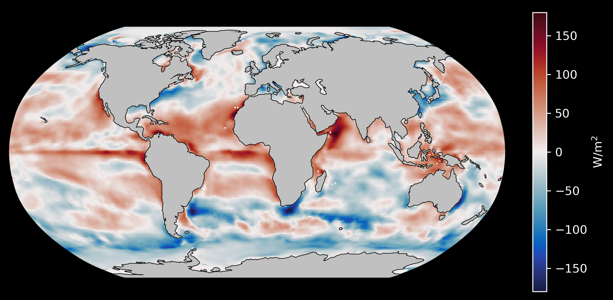
Heat Sources: Recall Lecture 2-2
Near the equator, the ocean uptakes heat
Increased solar radiation at the equator
Near the poles, the ocean loses heat
Temperature decreases, density increases

Slide 20


The Ocean Salinity Equation
$$\frac{∂S}{∂t}=−\vec{u}∙∇S+κ\frac{∂^{2}S}{∂t^{2}}+J_{S}$$
… advected salinity …
The change in salinity at a given location is associated with …
… diffusion…
… and other sources such as precipitation, evaporation, sea ice formation, etc
The salinity equation is typically written in terms of the Lagrangian derivative as:
$$\frac{DS}{Dt}=κ\frac{∂^{2}S}{∂t^{2}}+J_{S}$$

Slide 21
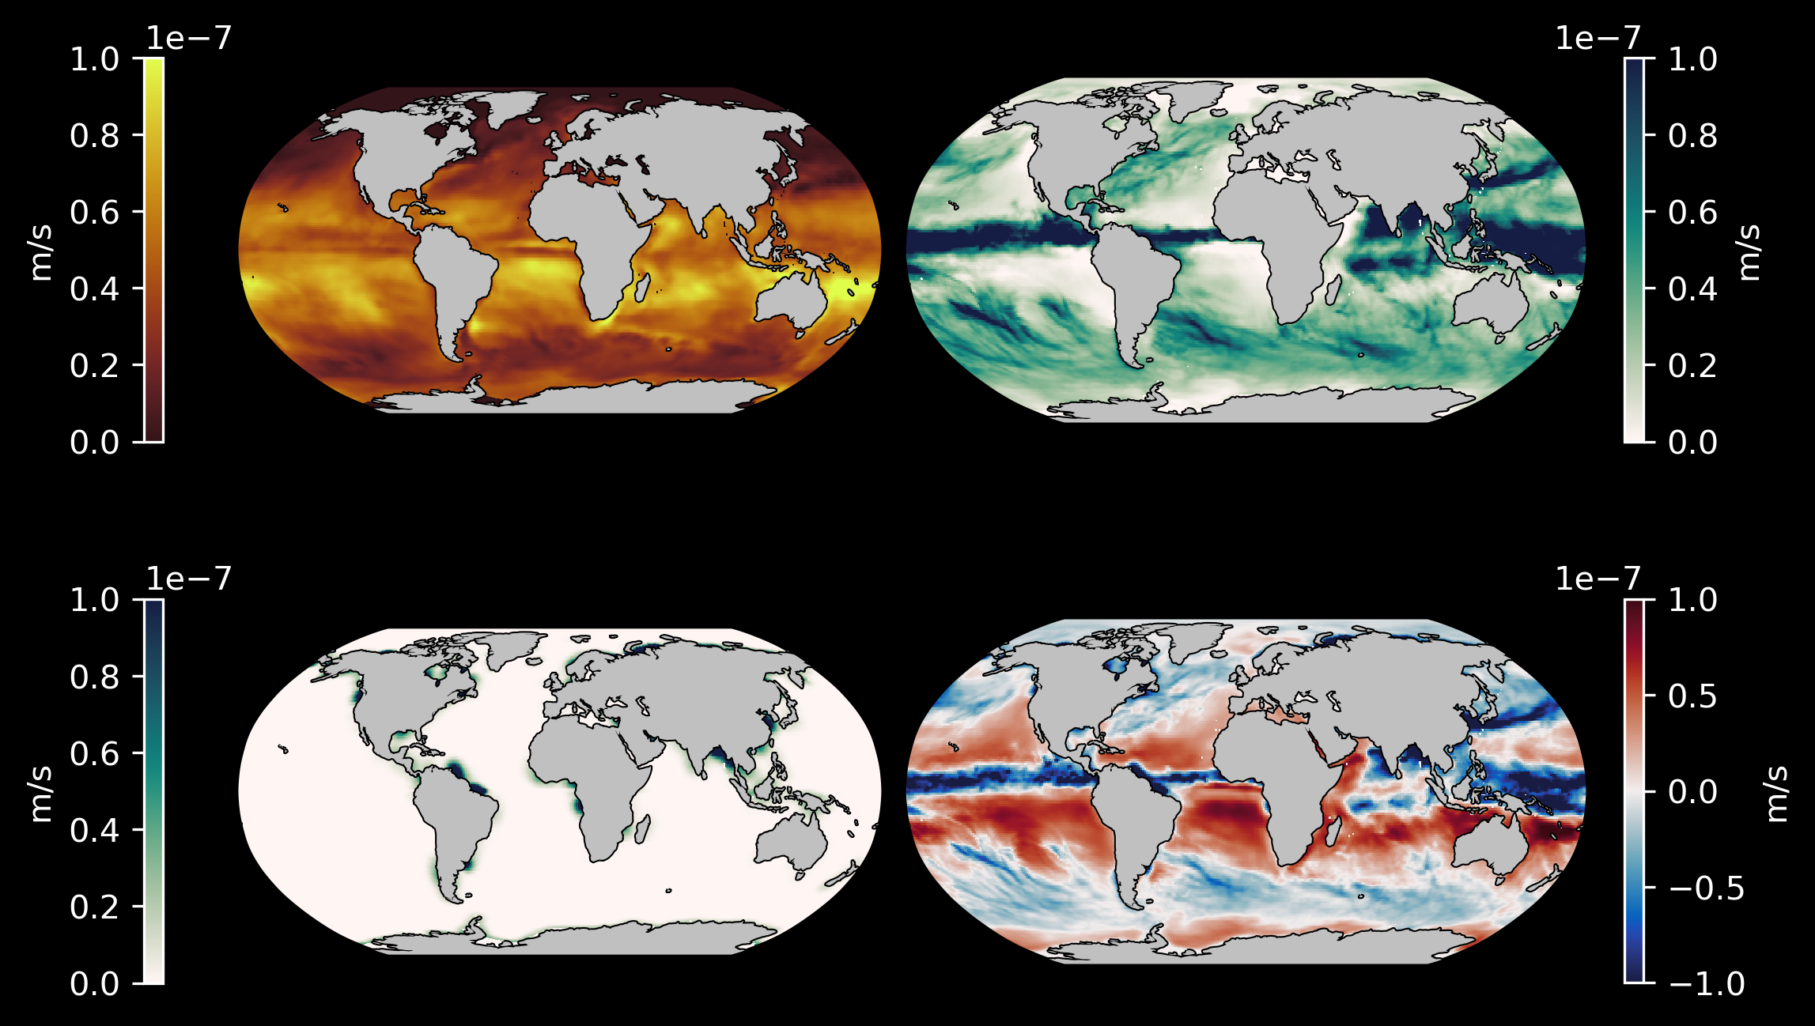
Salinity Sources (Lecture 2-2)
Evaporation (E)
Precipitation (P)
Near the equator, precipitation outweighs evaporation
In the gyres, evaporation is strong
Sea ice formation also increases salinity near the poles
Runoff (R)
E – P – R

Slide 22


Key Takeaway
Two fundamental ingredients for our ocean models
$$\frac{DΘ}{Dt}=κ\frac{∂^{2}Θ}{∂t^{2}}+\frac{J_{H}}{C_{p}ρ_{w}}$$
Heat Equation
$$\frac{DS}{Dt}=κ\frac{∂^{2}S}{∂t^{2}}+J_{S}$$
Salinity Equation

Slide 23
Activity: Advection in the Gulf Stream

